Slide 1
Social Networks through the Prism of Cognition
Paper: Radosław Michalski, Boleslaw K. Szymanski, Przemysław Kazienko, Christian Lebiere, Omar Lizardo and Marcin Kulisiewicz
Presentation: Luke Hamel

Slide 2
Introduction
How do we model social events?
Current network analysts often think of social events as discrete events, and edges update once for each event.
But human memory doesn’t work like this - our memories fade continuously over time, and many factors go into the strength of our memories.
CogSNet model tries to fix this by having edges which deteriorate over time and can be forgotten.

Slide 3
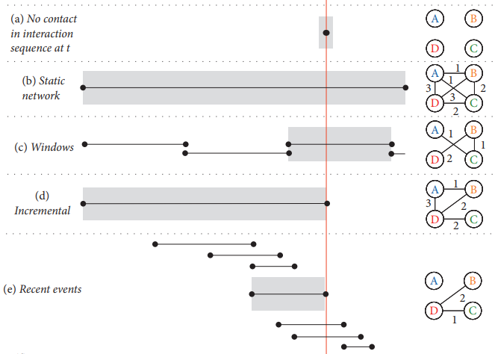
Other Models
Interaction Sequence
Static Network
Sliding Windows
Incremental
Recent Events (n=3)

Slide 4
CogSNet
Cognition-Driven Social Network Model
Models decay of memory over time
Parameters can be adjusted to fit subject with suitable data
Can account for recency effect

Slide 5
Forgetting Function
Human memory takes in a large amount of data, but only keeps a small amount - we need a function to model whether or not information is retained.
The forgetting function f must be monotonically nonincreasing, f(0) must equal 1, and f(t) ≥ 0 for all t > 0.
We have a few options for forgetting functions - linear, power, and logarithmic functions all work.
The paper only looks at exponential and power functions, as these better fit how human memory works. The functions are defined:
exp: f(Δt) = e^{−λΔt}
pow: f(Δt) = max(1, Δt)^{−λ}
λ = Forgetting Intensity

Slide 6
CogSNet Model
Uses 3 parameters:
Reinforcement Peak 0 < μ ≤ 1
Forgetting Intensity λ
Forgetting Threshold 0 < θ < μ
w_{ij} represents the weight between two nodes
t_{ij} represents the time of the preceding event for two nodes
Edge weight between two nodes at time t can be calculated as:

Slide 7
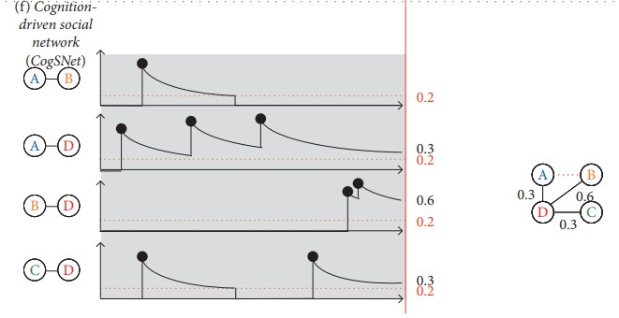
CogSNet Example
Forgetting Threshold θ = 0.2

Slide 8
Testing the Model
Data was used from the NetSense study, which collected data from calls and text messages of university students.
This dataset contained over 7 million events (texts and calls), as well as 578 surveys on the participants’ relationships.
The model was given the text and call data, and its predictions about each participants’ top contacts were compared to the self-reported data.
The Jaccard metric was used to measure the accuracy of the model:

Slide 9
Comparing the Model
For the Jaccard metric to be meaningful, we would want to compare it to other models that could predict the same information.
The CogSNet model was compared to:
A frequency-based model which ranked participants based on the number of interactions, but did not account for time.
A recency-based model which ranked participants based on the recency of their interactions.
A random sampling model which chose randomly from participants who had interacted with the given node.

Slide 10
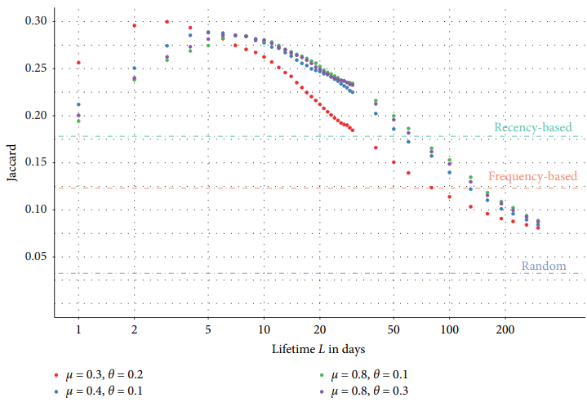
Exponential Forgetting Function

Slide 11
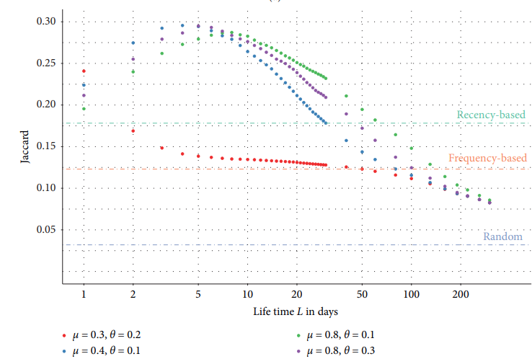
Power Forgetting Function

Slide 12
Conclusions
Modeling human memory important to accurately representing interaction dynamics in a social network.
The data used had many limitations - for instance, not accounting for in-person interactions. Data that better encompassed human interactions would most likely lead to more accurate results.
In addition, parameters could be adjusted per individual and per event, which could also increase accuracy.
A model similar to this could be used to monitor individuals for Alzheimer's and similar diseases that affect memory, as differences between someone’s memory and the model predictions could be an early warning.

